Slide 1
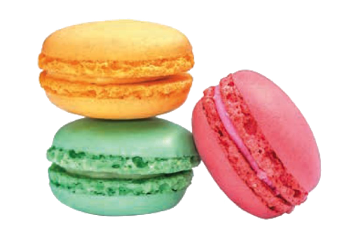
Homework 2 Job to be done
Desired Outcomes
Making macaron at condominium.
Function Job
Emotional Job
Social Job
Making a perfect macaron
Minimize the time its take to study recipe, equipment and preparing ingredient
Post on Instagram

